Slide 1

Note: The data and information in this document is reflective of a hypothetical situation and client. This document is to be used for KPMG Virtual Internship purposes only.
Sprocket Central Pty Ltd
Data analytics approach
Hong Trung Le – Intern Data Analyst

Slide 2
Note: The data and information in this document is reflective of a hypothetical situation and client. This document is to be used for KPMG Virtual Internship purposes only.
Agenda
Introduction
Data Exploration
Model Development
Interpretation

Slide 3
Note: The data and information in this document is reflective of a hypothetical situation and client. This document is to be used for KPMG Virtual Internship purposes only.
Introduction
Approach for analyzing New Customer List:
Age distribution
Number of purchases in 3 years
Job industry
Number of cars owned in each states

Slide 4
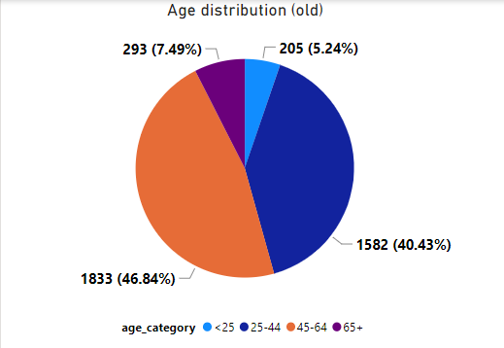
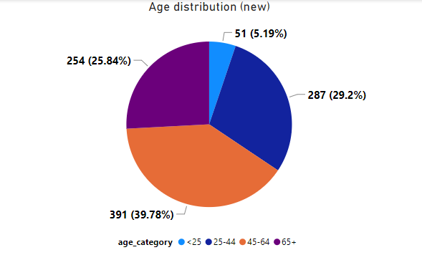
Note: The data and information in this document is reflective of a hypothetical situation and client. This document is to be used for KPMG Virtual Internship purposes only.
Data Exploration
In new customer list, the percentage of age under 25 is similar to the original customer
2 groups of age having significant increase in percentage are 25-44 and 65+
Group 45-64 still accounts for the most customers whether in the original customer list or the new one.

Slide 5
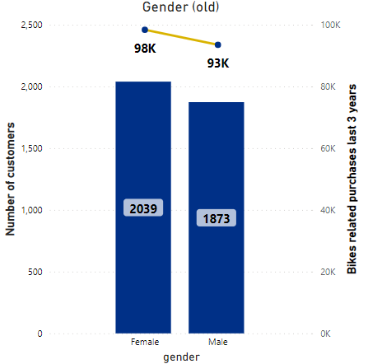
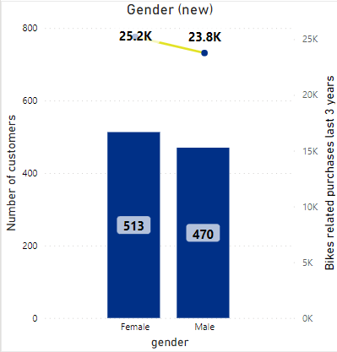
Note: The data and information in this document is reflective of a hypothetical situation and client. This document is to be used for KPMG Virtual Internship purposes only.
Data Exploration
There are similarities between original customer list and new customer list when it comes to gender distribution.
There are slightly more female customers compared to male.
Female customers also have bikes related purchases last 3 years slightly higher than male customers.

Slide 6
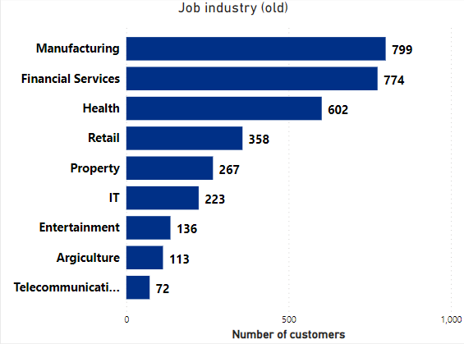
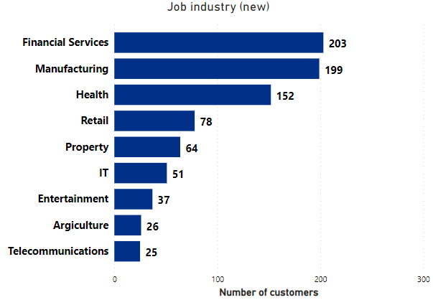
Note: The data and information in this document is reflective of a hypothetical situation and client. This document is to be used for KPMG Virtual Internship purposes only.
Data Exploration
In the original customer list, top 3 industry are Manufacturing, Financial Services and Health respectively.
In the new customer list, top 3 industry are Financial Services, Manufacturing and Health respectively

Slide 7
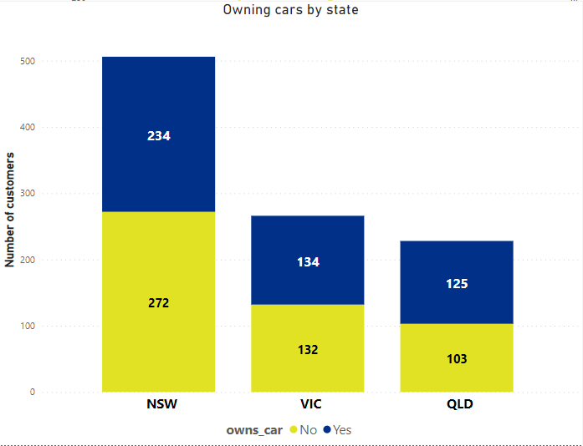
Note: The data and information in this document is reflective of a hypothetical situation and client. This document is to be used for KPMG Virtual Internship purposes only.
Data Exploration
Out of 3 states, NSW may be a potential market for company
NSW has fewer people owning a car than those who don’t, in contrast to the other 2 states.

Slide 8
Note: The data and information in this document is reflective of a hypothetical situation and client. This document is to be used for KPMG Virtual Internship purposes only.
Model Development
Customer Classification – Targeting potential customers
Aged between 45-64
Working in Financial service, Manufacturing or Health
Currently live in NSW

Slide 9
Note: The data and information in this document is reflective of a hypothetical situation and client. This document is to be used for KPMG Virtual Internship purposes only.
Thank you

